Slide 1

ENERGYWISE: Predicting energy consumption for a greener Tomorrow!
Presented By :
Priadharshni P (221801039)
Priyadarshini S (221801040)
Vijay Kumar V (221801505)
Department of Artificial Intelligence and Data Science

Slide 2
ABSTRACT
1
An advanced energy management solution helps residential users manage energy consumption effectively. Leveraging XGBoost, it predicts daily energy usage with accuracy, allowing users to anticipate consumption patterns and optimize energy use. The model integrates sophisticated feature engineering, including lagged variables, rolling statistics, and weather-energy interactions, to enhance predictive performance. Users receive actionable insights, personalized recommendations, and alerts for high consumption events. Rigorous testing through metrics like MAE and RMSE highlights its accuracy and reliability. By fostering smarter energy practices, the system enables cost savings and supports environmental sustainability, empowering users to adopt sustainable habits.
Department of Artificial Intelligence and Data Science

Slide 3
INTRODUCTION
2
INTRODUCTION: Our goal is to develop a forecasting model to predict future energy consumption in residential buildings based on historical usage data, weather conditions and occupant information in order to reduce cost and to predict future energy usage accurately.
OVERVIEW: EnergyWise is designed to address the issue of unexpected high electricity bills faced by households. By accurately predicting energy consumption in advance can help users to plan better and manage costs effectively. The project leverages the XGBoost algorithm to provide precise daily energy usage predictions, enabling users to make informed decisions, optimize energy use, and support sustainability efforts.
Department of Artificial Intelligence and Data Science

Slide 4
EXISTING SYSTEM
3
The current approach to predicting energy consumption employs a range of machine learning techniques, including Linear Regression, Decision Trees, Support Vector Machines (SVM), and Deep Learning models. These algorithms analyze historical data along with various factors such as temperature, humidity, time of day, and day of the week. Linear Regression identifies simple linear relationships between input variables and energy consumption. Decision Trees capture more complex, non-linear patterns, while Random Forest, an ensemble technique, enhances prediction accuracy by combining multiple decision trees. SVMs are used to find the optimal hyperplane that separates different data points, aiding in accurate predictions. Deep Learning models, with their ability to learn complex hierarchical features, are particularly useful in modeling intricate relationships within the data, thus improving the overall prediction accuracy and robustness for energy consumption forecasting.
Department of Artificial Intelligence and Data Science

Slide 5
4
DRAWBACKS OF EXISTING SYSTEM
Models like SVM and Deep Learning often lack transparency, making it difficult to interpret their predictions.
Algorithms such as Deep Learning require large amounts of data for training, which may not always be available.
Complex models like Decision Trees and Deep Learning are prone to overfitting, especially with insufficient or noisy data.
Some algorithms, particularly Deep Learning and SVM, can be computationally expensive and may not scale well with large datasets.
Techniques like Random Forest and SVM may struggle with fine-tuning, requiring significant computational resources and hyperparameter adjustments.
Department of Artificial Intelligence and Data Science

Slide 6
PROPOSED SYSTEM
5
The proposed EnergyWise system is an advanced energy management solution designed to optimize energy consumption for residential buildings. It leverages smart meters and environmental sensors to collect real-time data, which is analyzed using the XGBoost algorithm to provide accurate energy consumption forecasts. It incorporates advanced feature engineering, including lagged variables and weather interactions, to enhance prediction accuracy. The system offers energy insights, and smart alerts for high consumption events. By analyzing patterns and optimizing energy usage, the system helps users reduce waste and lower costs. It uses metrics like MAE and RMSE for model evaluation to ensure reliable performance. The solution supports sustainability efforts by promoting energy-efficient practices. Ultimately, the system empowers users to make data-driven decisions for smarter energy management.
Department of Artificial Intelligence and Data Science

Slide 7
ADVANTAGES OF PROPOSED SYSTEM
6
❖Optimized Energy Consumption: EnergyWise enables users to efficiently manage their energy usage by providing actionable insights, reducing waste and lowering energy costs.
❖Accurate Energy Forecasting: Using the XGBoost algorithm, the system delivers precise energy consumption predictions, helping users plan better and avoid peak-time energy costs.
❖User-Friendly Dashboard: EnergyWise features an intuitive and accessible dashboard, making it easy for users to view real-time data, energy forecasts, and personalized recommendations.
❖Advanced Feature Engineering: Enhances prediction accuracy with lagged variables and interactions between weather and energy data.
Department of Artificial Intelligence and Data Science

Slide 8
REQUIREMENTS
7
FUNCTIONAL REQUIREMENTS
NON - FUNCTIONAL REQUIREMENTS
Data Collection: The system must collect energy usage data from smart meters and environmental data (e.g., temperature, humidity) from external sources.
Energy Forecasting: Use the XGBoost algorithm to predict energy consumption patterns based on historical and real-time data.
Alerts and Notifications: Send actionable alerts for unusual energy consumption patterns to users in real-time.
Dashboard: Provide a user-friendly dashboard that displays real-time energy data, forecasts, and recommendations.
Performance: The system should provide energy consumption forecasts with minimal latency, ensuring real-time insights are available within 2 seconds of data retrieval.
Usability: The dashboard should have a user-friendly interface with intuitive navigation for non technical users.
Security: Ensure robust data encryption and authentication for secure access to user and system data.
Efficiency: The system has optimized computational resources ensuring CPU usage stays under 70% and memory usage under 75% during peak operations.
Department of Artificial Intelligence and Data Science

Slide 9
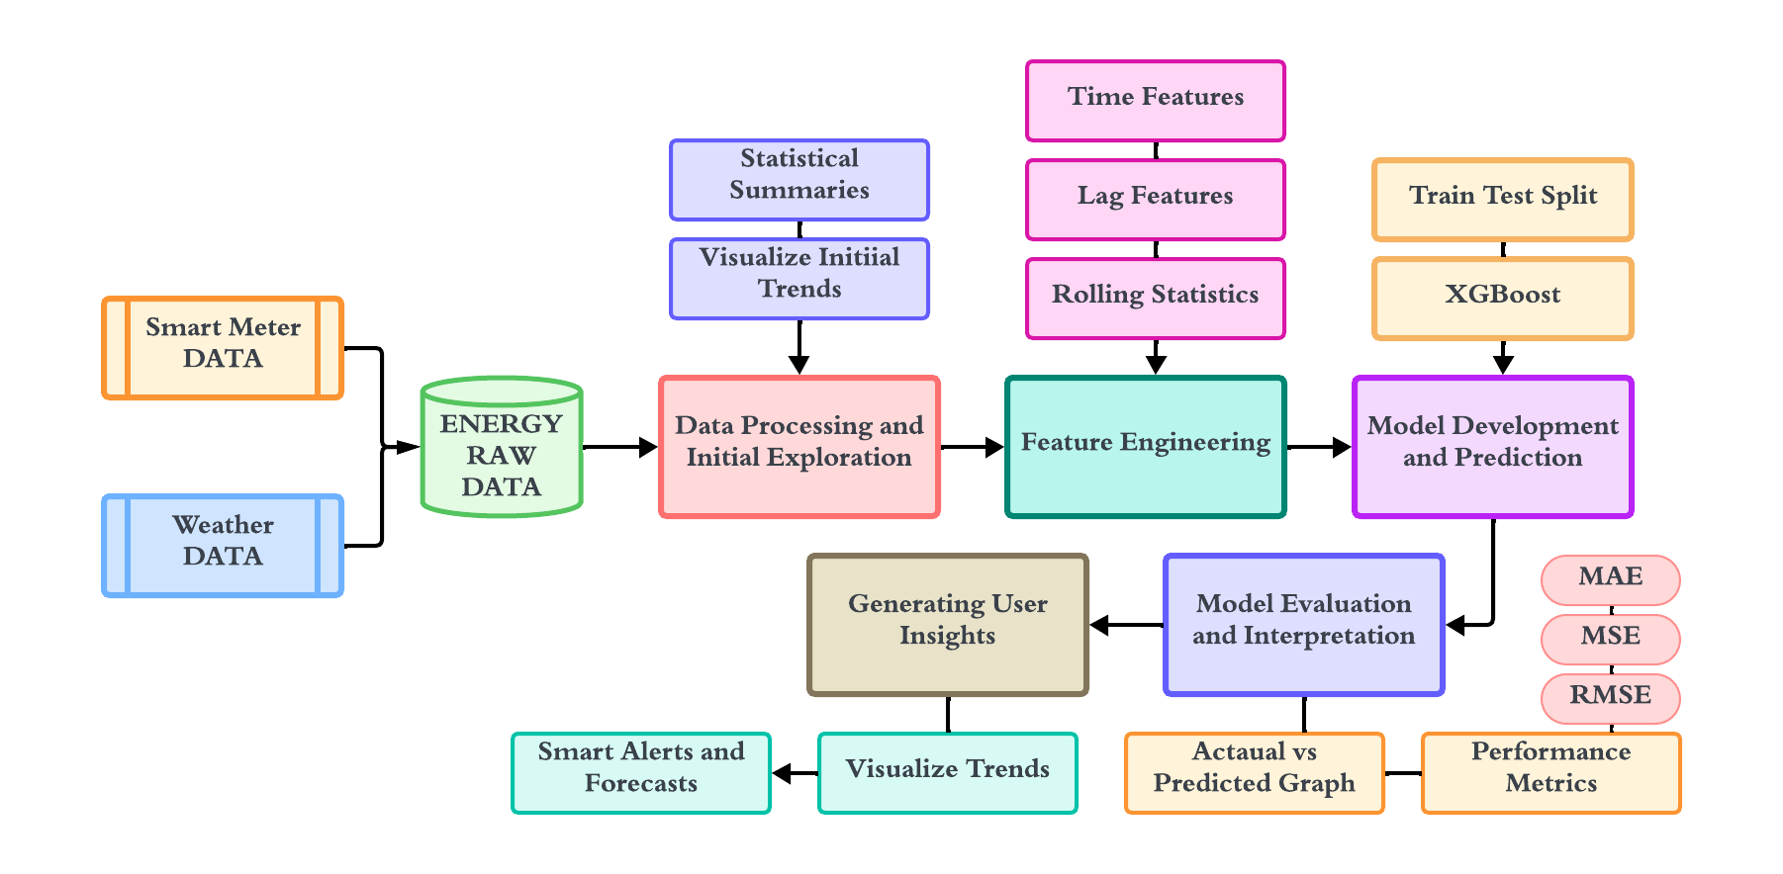
8
ARCHITECTURE DIAGRAM
Department of Artificial Intelligence and Data Science

Slide 10
ARCHITECTURE DIAGRAM
9
This architecture diagram explains the working of the EnergyWise system for energy consumption prediction. The process begins with collecting data from smart meters (real-time energy usage) and weather sources (temperature, humidity). These datasets are combined into energy raw data, which undergoes processing to clean, explore, and identify patterns through statistical summaries and visualizations. Next, feature engineering extracts important characteristics like time-based trends, lagged features, and rolling statistics, making the data ready for predictive modeling. The XGBoost algorithm is used to develop a prediction model by splitting the data into training and testing sets. The predictions are evaluated using metrics like MAE, MSE, and RMSE. The results are visualized as graphs and insights are generated to help users optimize energy usage. Alerts and forecasts are also provided for better decision-making.
Department of Artificial Intelligence and Data Science

Slide 11
Module 1: Data Preprocessing
10
Step 1: Load and inspect the dataset by reading the CSV file and displaying the first few rows, dataset info, and summary statistics.
Step 2: Identify and handle missing values by checking for null values and printing the count of missing values per column.
Step 3: Convert the 'date' column to datetime format and extract time-related features like hour, day, and month.
Step 4: Visualize key features like active power over time, temperature distribution, and the correlation heatmap of numerical data.
Step 5: Plot average energy consumption patterns by hour, day of the week, and month to identify trends and seasonal variations.
Step 6: Create additional features such as is_weekend based on the day of the week and update the dataset for further analysis.
Department of Artificial Intelligence and Data Science

Slide 12
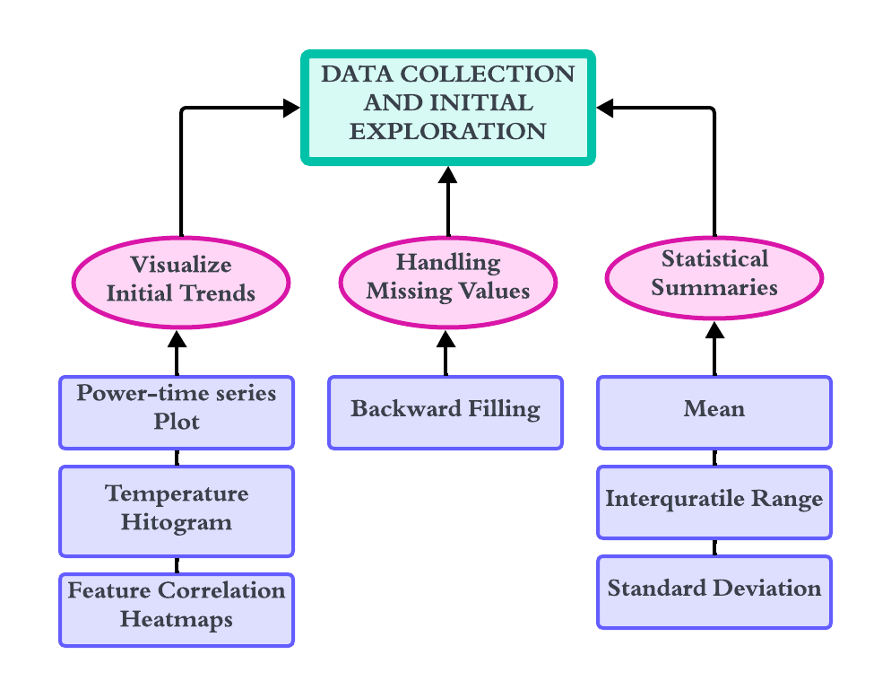
11
DFD – MODULE 1
Department of Artificial Intelligence and Data Science

Slide 13
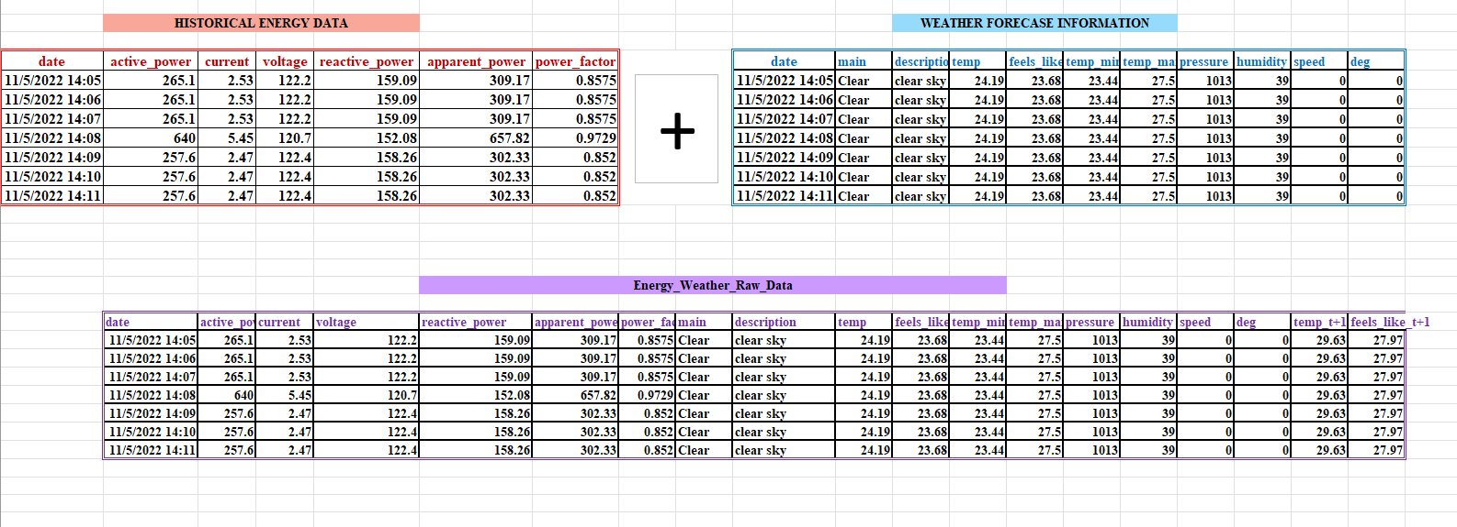
12
HISTORICAL DATA AND WEATHER DATA MERGING
Department of Artificial Intelligence and Data Science

Slide 14



13
PREPROCESSING
Correlation Heatmap: Calculates the correlation between numerical features:
Average Power by Grouping: Groups active_power by time intervals (e.g., hour, day, month) and calculates the mean:
Normalize(MinMaxScaler):- It is used convert the data in different scale to a defined range typically between the 0 and 1
Department of Artificial Intelligence and Data Science

Slide 15
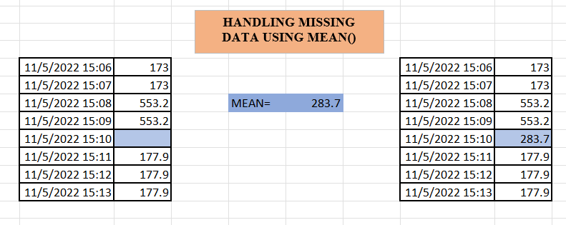
14
HANDLING MISSING DATA VALUES
Department of Artificial Intelligence and Data Science

Slide 16
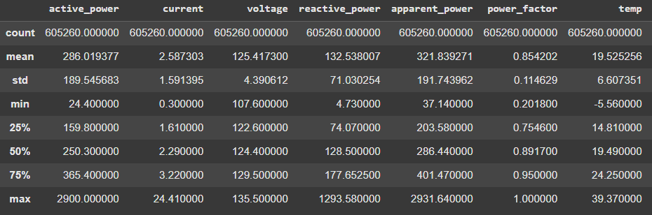
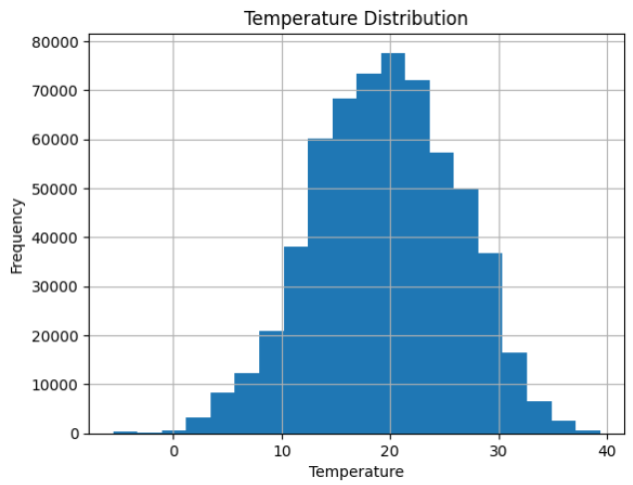
15
OUTPUT – MODULE 1
Figure 1- Statistical Summaries of Data
Figure 2- Temperature Distribution – Histogram
The statistical summary of the dataset reveals key insights, such as the completeness of data entries and the range of values for each variable as shown in Figure 1
The histogram as shown in Figure 2, defines the underlying distribution of temperature values before incorporating them into our forecasting model.
Department of Artificial Intelligence and Data Science

Slide 17
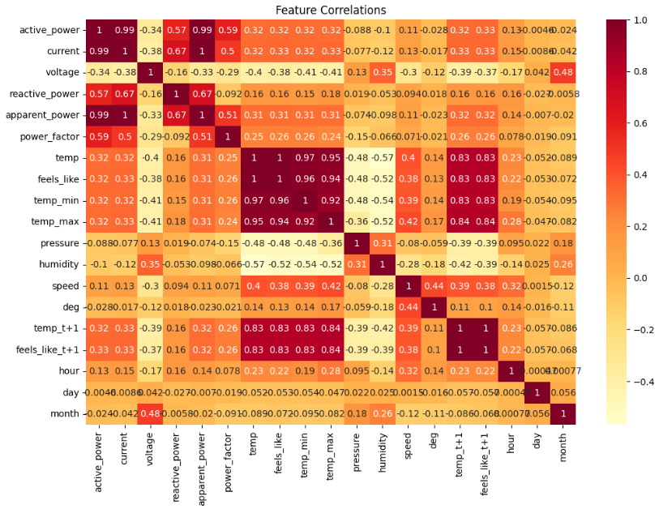
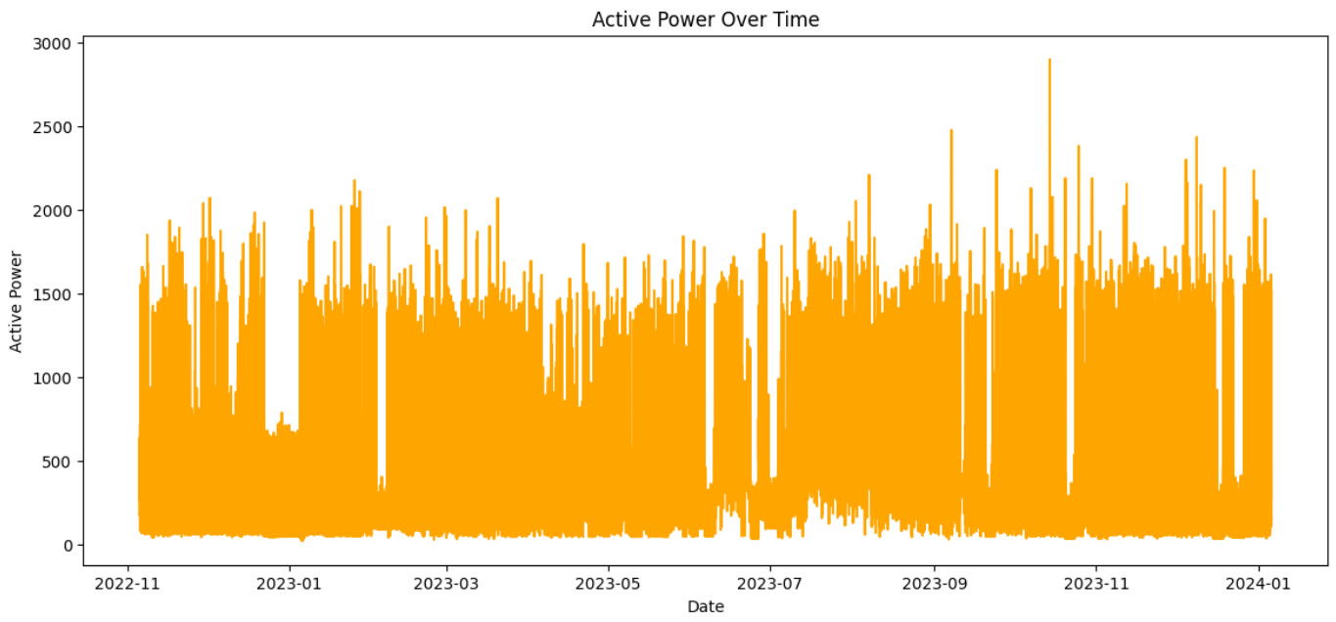
16
OUTPUT MODULE -1
Figure 3. Active Power over Time Series Plot
Figure 4. Feature Correlation Heatmap
The line plot as shown in Figure 3, serves as an important step in understanding how active power consumption varies over time
As mentioned in Figure 4, Exploring correlations identifies relationships between different factors helping select key features
Department of Artificial Intelligence and Data Science

Slide 18
Module 2: Feature Engineering
17
Step 1: Identify time based features to capture patterns in energy consumption.
Step 2: Apply rolling window on time based feature to compute rolling mean,
rolling standard deviation which captures trends over time.
Step 3: Create lagged version of the data to predict future values based on past observations.
Step 4: Combining rolling statistics, time based features and lagged features transforms raw data into meaningful inputs which enhances prediction accuracy.
Step 5: Ensure all features are normalized and free from missing values, ready for model training.
Department of Artificial Intelligence and Data Science

Slide 19
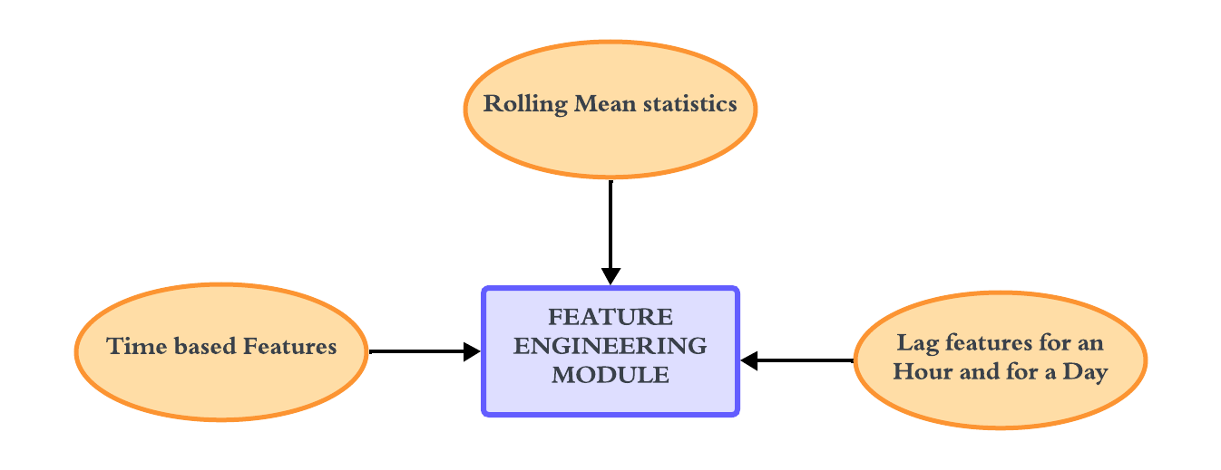
18
DFD – MODULE 2
Department of Artificial Intelligence and Data Science

Slide 20
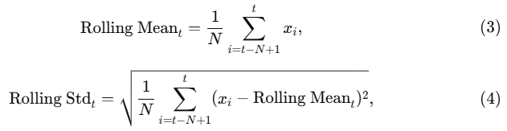
19
FEATURE ENGINEERING
Lag Features:
Lag features look at past values to help the model understand recent trends, making it easier to predict future values based on short- and long-term usage patterns.
Rolling Statistics:
Rolling statistics smooth out short-term fluctuations and highlight longer-term trends.
Rolling Mean (24 Hours): Calculates the average usage over a full day.
Rolling Standard Deviation (24 Hours): Shows variability in usage over the past 24 hours.
Department of Artificial Intelligence and Data Science

Slide 21
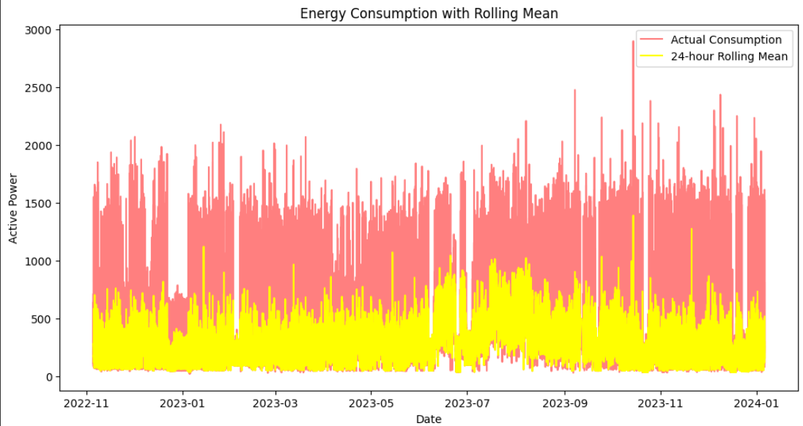
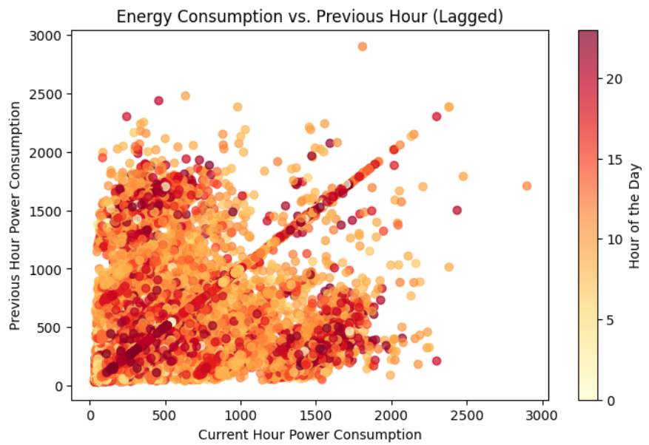
20
OUTPUT – MODULE 2
Figure 5. Energy Consumption with Rolling Mean Time Series Plot
Figure 6. Energy Consumption over the previous hour Scatter Plot
The Line Plot as shown in the Figure 5, shows variability in energy usage over the past 24 hours, which can help detect unusual spikes or drops.
The Line Plot as shown in the Figure 6, shows the energy usage from the same hour the previous day. This is helpful for capturing daily usage patterns.
Department of Artificial Intelligence and Data Science

Slide 22
Module 3: Model Training and Prediction
21
Prepare Data: Split the dataset into input features (X) and target variable (y), and remove unnecessary columns.
Split Dataset: Divide the data into training and testing sets using an 80-20 split.
Clean Data: Drop unnecessary columns from the dataset (e.g., date, main, description).
Initialize Model: Configure the XGBRegressor with appropriate hyperparameters.
Train Model: Fit the model on the training data (X_train, y_train).
Predict Outcomes: Use the trained model to predict values on the testing set (X_test).
Department of Artificial Intelligence and Data Science

Slide 23
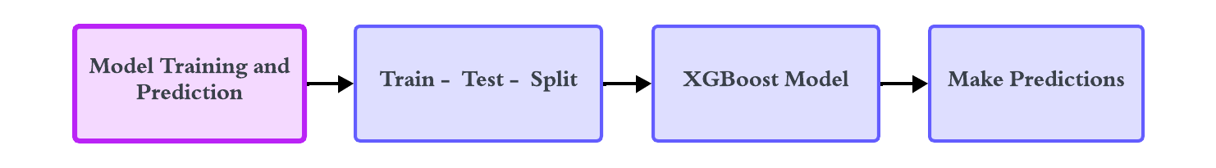
22
DFD – MODULE 3
Department of Artificial Intelligence and Data Science

Slide 24
23
XGBoost Algorithm
Algorithm 1: XGBoost model for Energy Consumption Prediction
Initialize: Set nodeSet ← {0}, rowSet ← {0, 1, 2, ..., N} // Initialize nodes and row sets Define High Usage Threshold as μ + 2σ for alert generation for t ← 1 to num_trees: for i ← 1 to d: for node in nodeSet: usedRows ← rowSet[node] // Identify rows to use for splitting for k ← 1 to m: H ← newHistogram() // Create a new histogram for splitting for j in usedRows: bin ← I.f[k][j].bin // Assign data to bins H[bin].y ← H[bin].y + I.y[j] H[bin].n ← H[bin].n + 1 end for best_split ← find_best_split(H) // Find best split based on the histogram update_tree(node, best_split) // Update tree with the best split update_rowSet(node, best_split) // Update row set for the next iteration end for end for end for boosting_update() // Update model using boosting add_tree_to_ensemble() // Add new tree to the ensemble end for
Department of Artificial Intelligence and Data Science

Slide 25
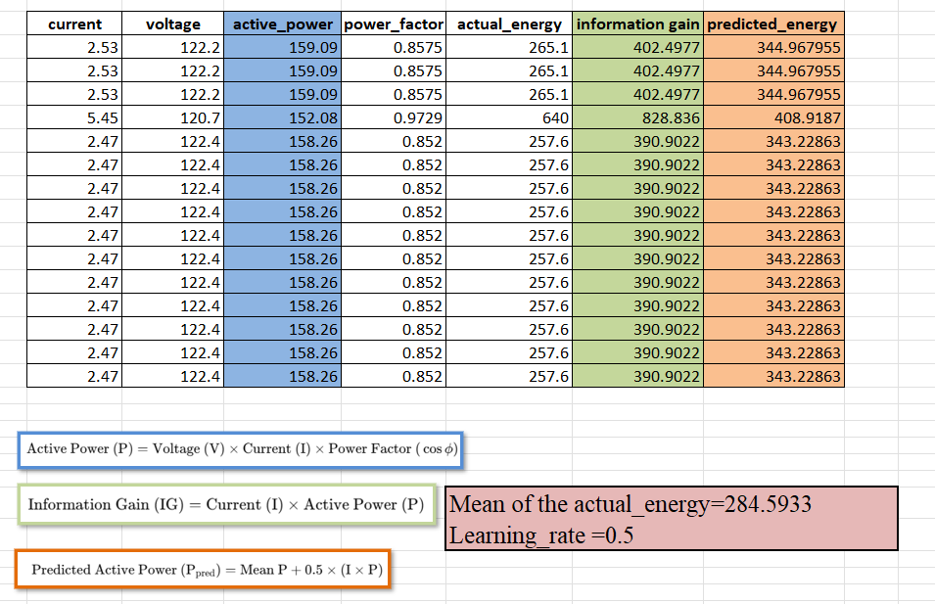
24
Mathematical Calculation
Department of Artificial Intelligence and Data Science

Slide 26
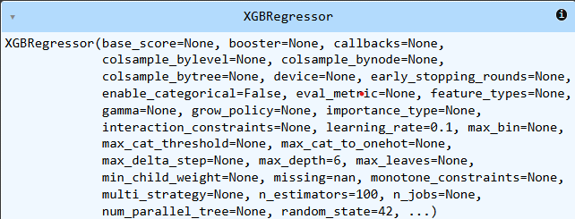
25
OUTPUT – MODULE 3
Figure 7. XGBRegressor Model Overview
The Figure 7 shows the initialization parameters of the XGBRegressor class in the XGBoost library, used for training gradient-boosted regression models with customizable hyperparameters
Department of Artificial Intelligence and Data Science

Slide 27
Module 4: Model Evaluation and Interpretation
26
Evaluate Model Predictions: Compute evaluation metrics: Mean Absolute Error (MAE), Mean Squared Error (MSE), and (RMSE) to quantify the model's prediction accuracy.
Visualize Predictions: Create a scatter plot comparing actual (y_test) vs. predicted values to assess how well the model aligns with observed data.
Analyze Residuals: Calculate and visualize residuals (errors between actual and predicted values) to check their distribution for randomness and normality.
Analyze Feature Importance: Extract and visualize the importance of features used in the model to understand which factors significantly influence predictions.
Refine and Retrain: Address any mismatches or residual trends, and retrain the model if necessary to improve its accuracy and reliability.
Department of Artificial Intelligence and Data Science

Slide 28
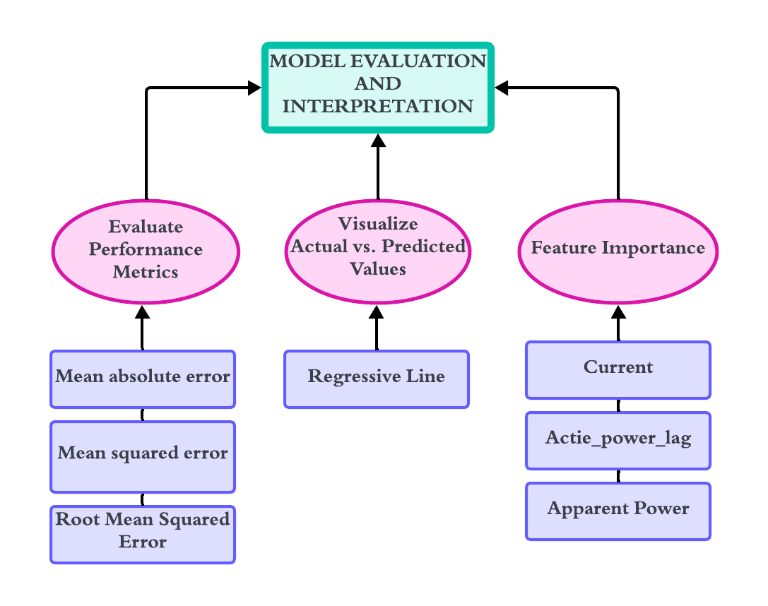
27
DFD – MODULE 4
Department of Artificial Intelligence and Data Science

Slide 29

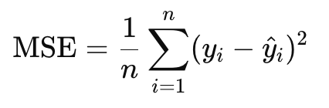
28
EVALUATION
MAE(Mean Absolute Error):- It is a absolute difference between the predicted and actual values. If mae is 100 then the model deviate by 100 units from the actual value
MSE(Mean Squared Error):- It is the average of the squared error between the predicted and actual values. It gives more weight to large errors. If the mse is 100 the deviate by 10 units from the actual value.
Department of Artificial Intelligence and Data Science

Slide 30
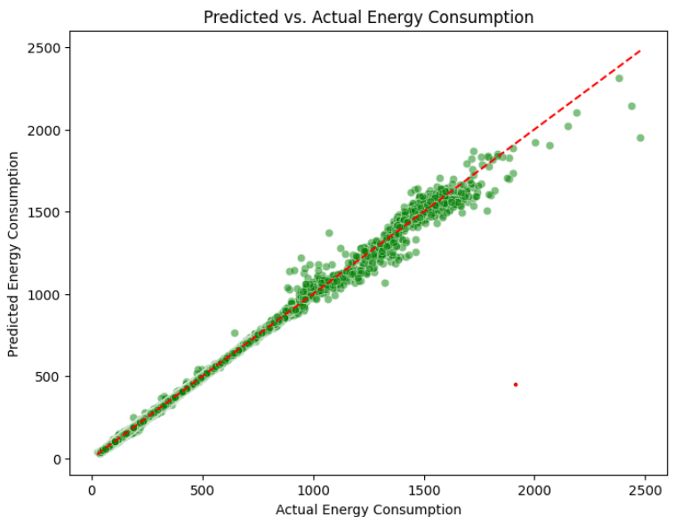
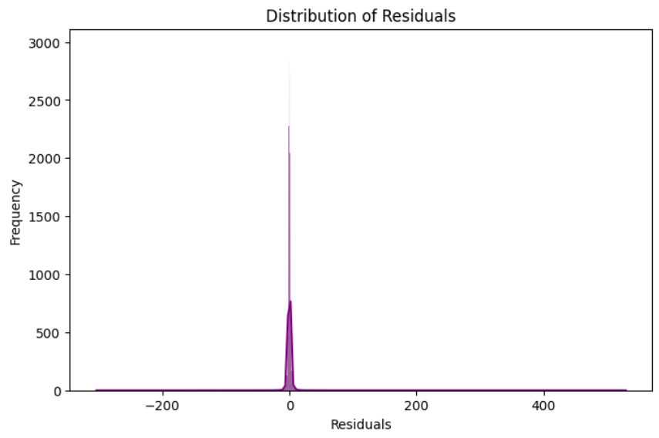
29
OUTPUT – MODULE 4
Figure 8. Predicted vs. Actual Energy Consumption Regression Line
Figure 9. Distribution of Residual – Histplot
As shown in Figure 8 helps visualize how well the model captures the data's trends. The closer the points are to the line y = x, the better the model.
A histogram of residuals as shown in Figure 9, can indicate whether there’s any systematic error in the model’s predictions.
Department of Artificial Intelligence and Data Science

Slide 31
Results of Module 4
30
Mean Absolute Error (MAE): The model achieved an MAE of 1.66 kWh, indicating that, on average, predictions deviate from actual energy consumption by 1.66 kWh.
Mean Squared Error (MSE): The MSE value of 28.89 reflects the squared average of errors, showing the presence of some larger discrepancies.
Root Mean Squared Error (RMSE): The RMSE of 5.38 highlights the overall magnitude of prediction errors, representing significant deviations in some cases.
Effectiveness: These metrics demonstrate the model's strong predictive performance with relatively low errors given the complexity of energy consumption patterns.
Department of Artificial Intelligence and Data Science

Slide 32
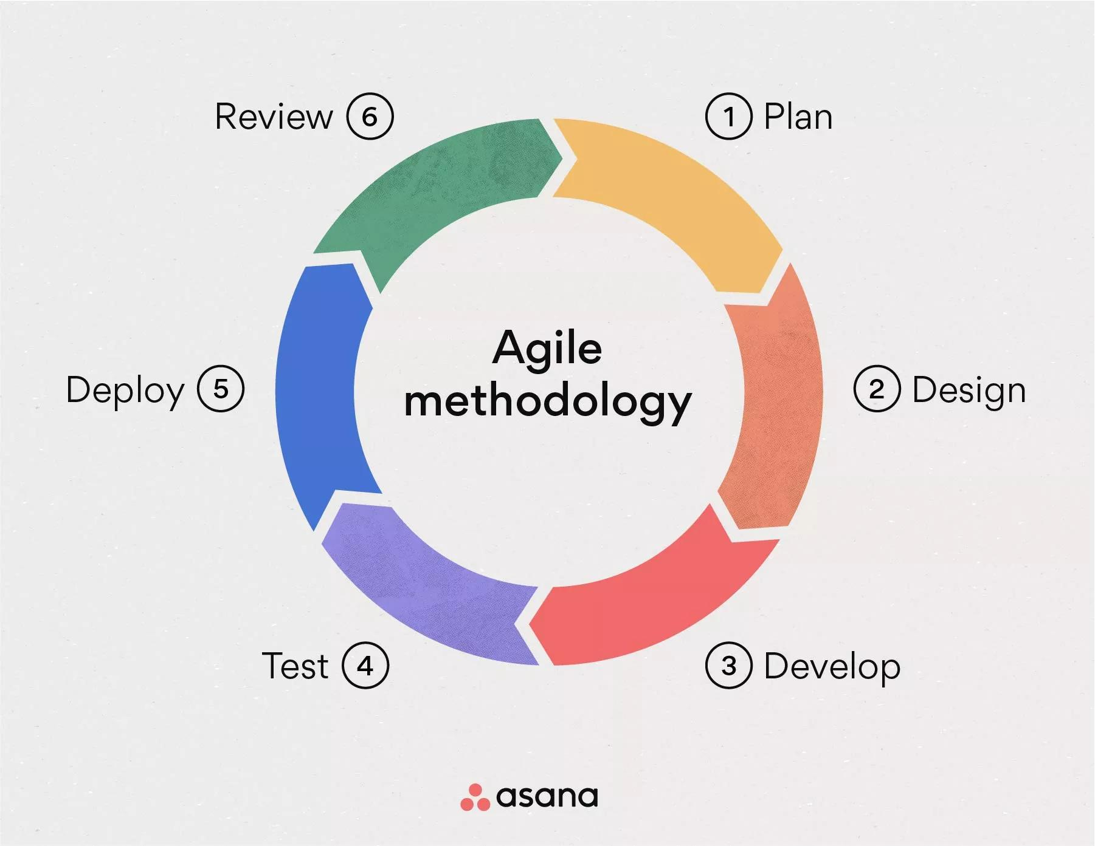
31
AGILE MODEL
For the EnergyWise system, the Agile Model is ideal as it allows iterative development of key features like real-time data collection, predictive analytics, and the user-friendly dashboard. Each sprint could focus on delivering incremental functionalities—such as integrating smart meters, refining the XGBoost model, or enhancing data visualizations. Agile ensures continuous user feedback, enabling flexibility to adapt to changing requirements and improving the system’s effectiveness in optimizing energy consumption.
Department of Artificial Intelligence and Data Science

Slide 33
32
TESTING
UNIT TESTING:
For the EnergyWise system, unit testing plays a critical role in ensuring the reliability and accuracy of individual components. Each module, such as data collection, preprocessing, feature engineering, and prediction, is tested independently to verify that it functions as expected. For instance, the data cleaning process is tested to handle missing values, while the XGBoost model is validated for correct predictions. Unit tests help identify bugs early in the development cycle, reducing downstream issues. Testing scripts are automated where possible to maintain consistency and save time. By focusing on individual units, we ensure the robustness and quality of the overall system.
Department of Artificial Intelligence and Data Science

Slide 34
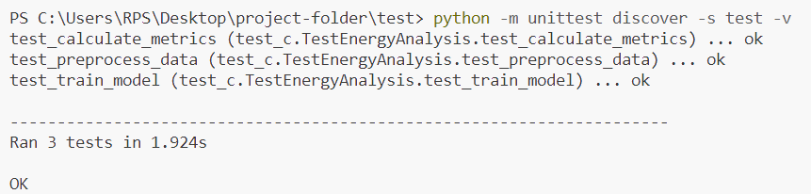
33
OUTPUT SCREENSHOTS
Department of Artificial Intelligence and Data Science

Slide 35
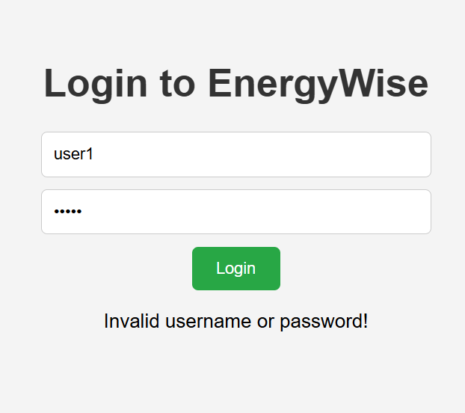
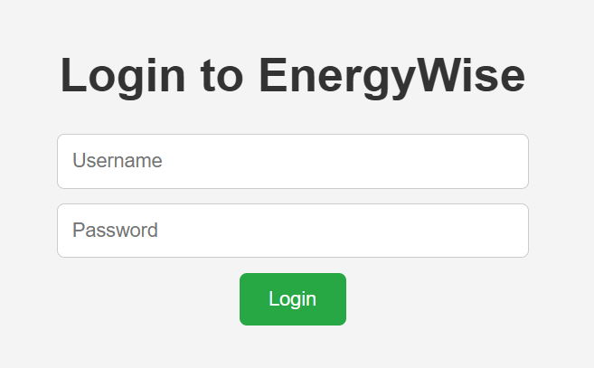
34
OUTPUT SCREENSHOTS
Department of Artificial Intelligence and Data Science

Slide 36
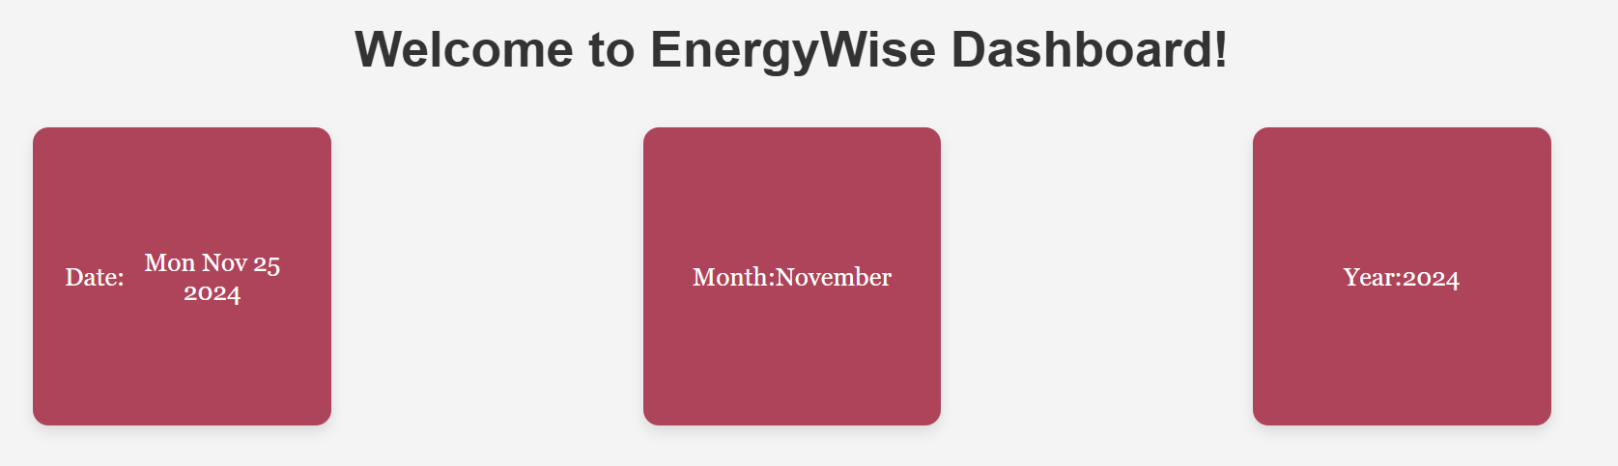
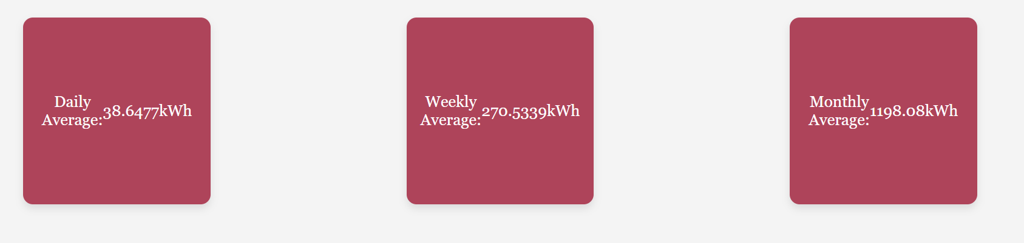
35
OUTPUT SCREENSHOTS
Department of Artificial Intelligence and Data Science

Slide 37
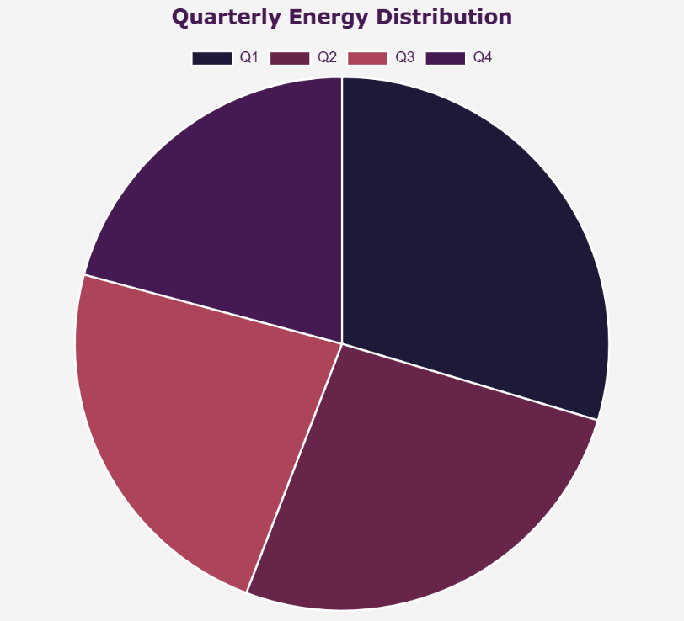
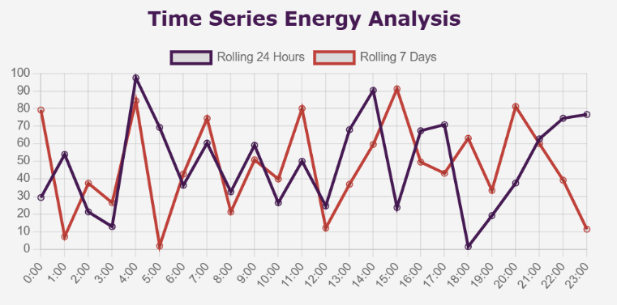
36
OUTPUT SCREENSHOTS
Department of Artificial Intelligence and Data Science

Slide 38
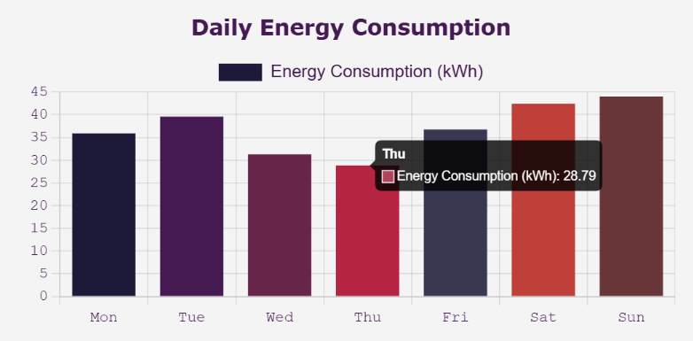
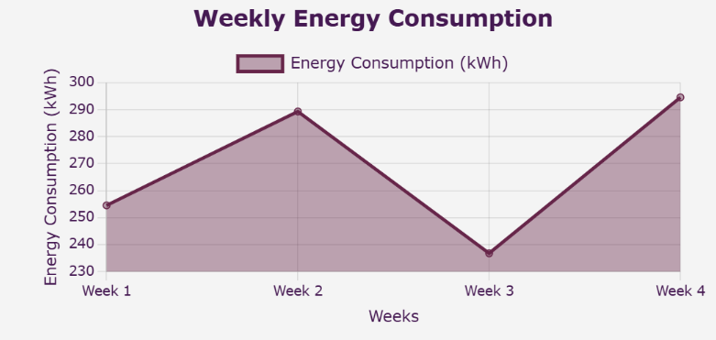
37
OUTPUT SCREENSHOTS
Department of Artificial Intelligence and Data Science

Slide 39
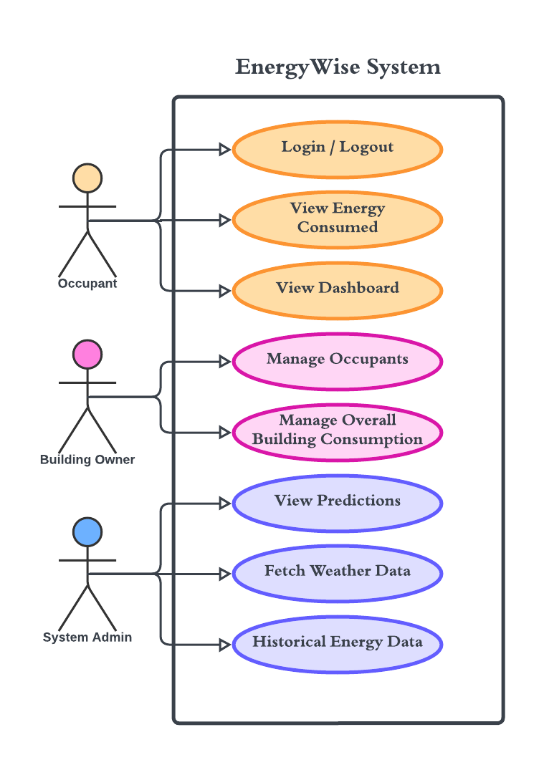
38
USE CASE DIAGRAM
This use case diagram illustrates the interactions of three primary actors—Occupant, System Admin, and Building Owner—with the energy management system. The Occupant can log in, view energy consumption, and receive notifications. The System Admin manages weather data, appliances, and predictions, while the Building Owner oversees building consumption and occupants.
Department of Artificial Intelligence and Data Science

Slide 40
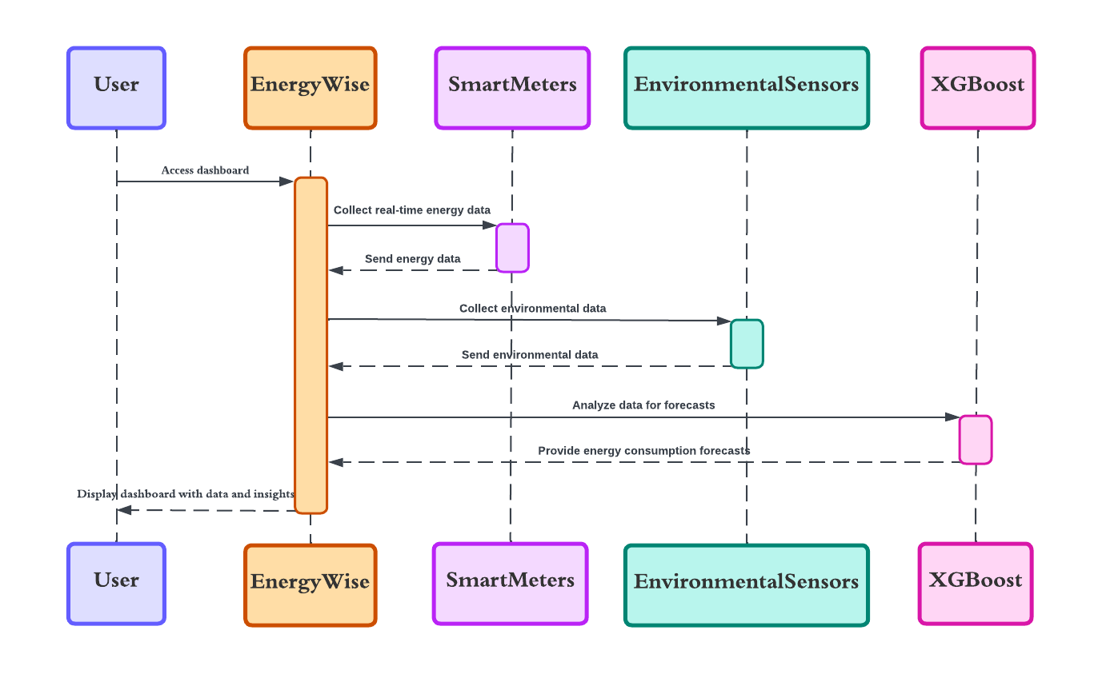
39
SEQUENCE DIAGRAM
This sequence diagram outlines the interactions within the EnergyWise system. Users access the dashboard, while EnergyWise collects real-time energy data from SmartMeters and environmental data. These inputs are analyzed using XGBoost to forecast energy consumption. The system then sends insights and predictions back to EnergyWise dashboard.
Department of Artificial Intelligence and Data Science

Slide 41
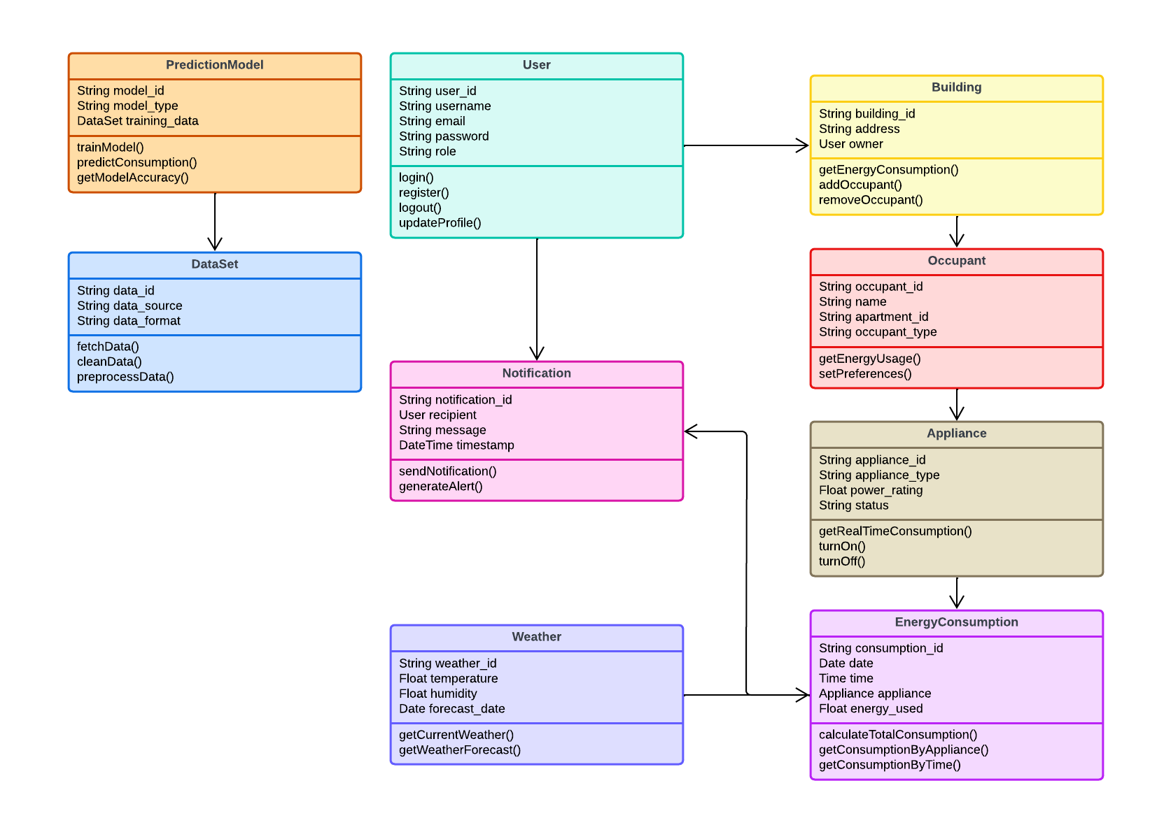
40
CLASS DIAGRAM
The class diagram represents key classes include PredictionModel, User, Notification, Building, Occupant, Appliance, EnergyConsumption, DataSet, and Weather. Each class specifies attributes and methods, illustrating data flow and functionality like energy prediction, user management, notifications, appliance control, and weather integration for optimized energy consumption.
Department of Artificial Intelligence and Data Science

Slide 42
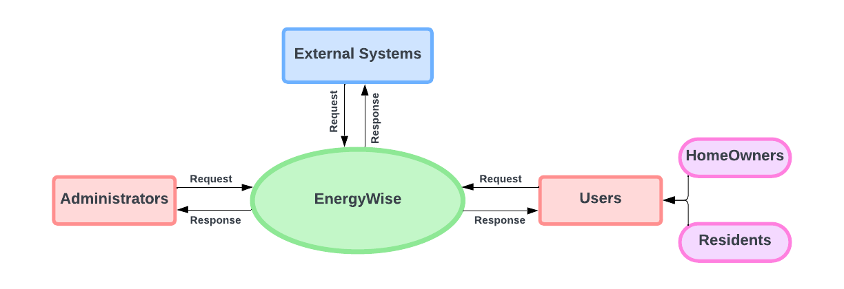
41
DATA FLOW DIAGRAM LEVEL 0
Department of Artificial Intelligence and Data Science

Slide 43
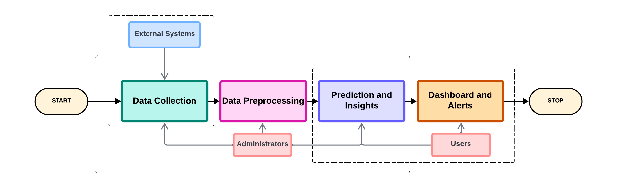
42
DATA FLOW DIAGRAM LEVEL 1
Department of Artificial Intelligence and Data Science

Slide 44
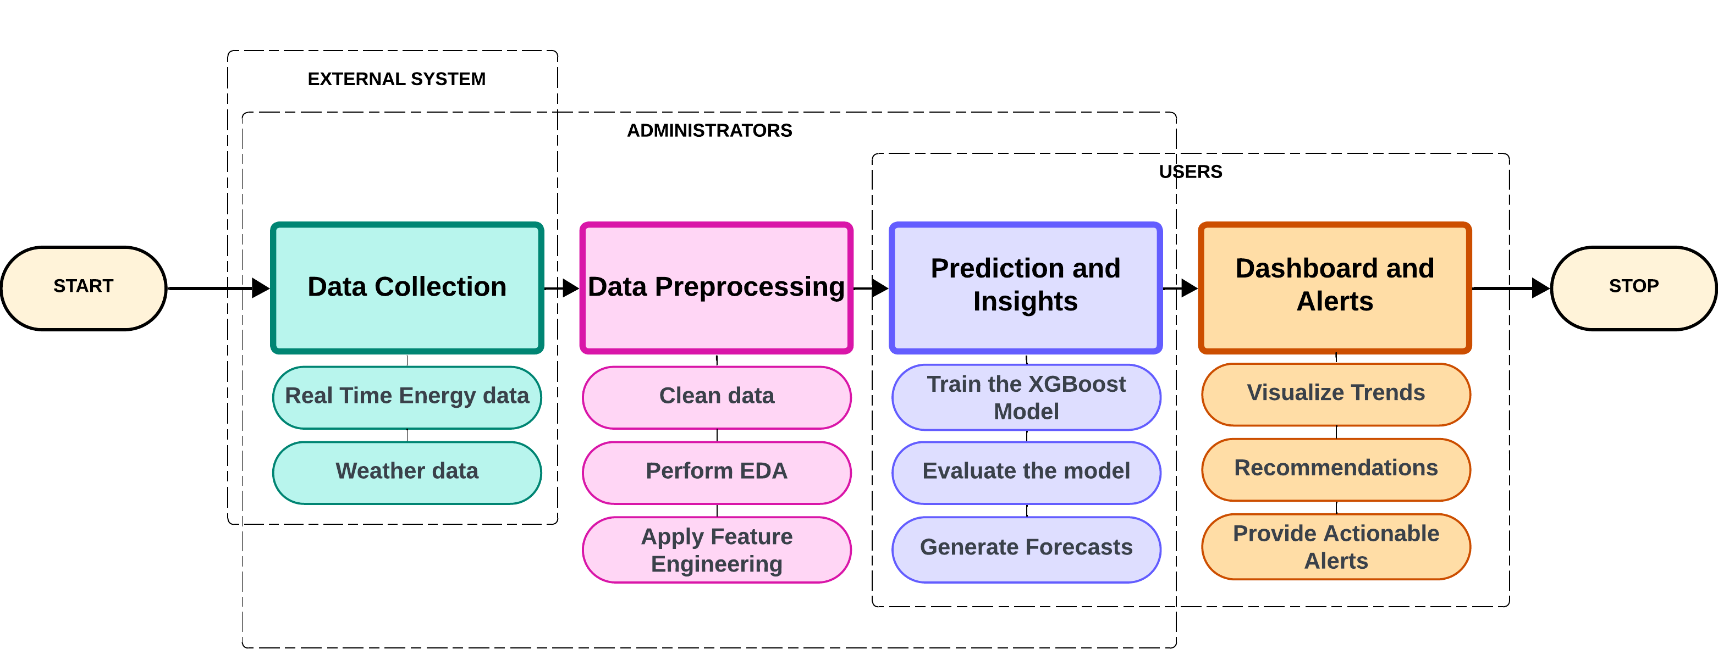
43
DATA FLOW DIAGRAM LEVEL 2
Department of Artificial Intelligence and Data Science

Slide 45
RESULTS AND DISCUSSION
44
The EnergyWise system successfully optimizes energy consumption through data collection, predictive analytics, and actionable insights. The XGBoost algorithm demonstrated high accuracy in energy forecasting, with evaluation metrics such as MAE and RMSE validating its performance. A user-friendly dashboard offers clear visualizations, enabling users to monitor consumption patterns and make informed decisions. Unit testing verified the functionality of key modules like data preprocessing, feature engineering, and prediction, reducing errors and ensuring smooth deployment. The seamless integration of smart meters and weather data highlights the system’s scalability. Feedback from users confirmed the effectiveness of personalized recommendations, reinforcing the system’s value as an advanced, user-centric solution for energy management that addresses environmental challenges.
Department of Artificial Intelligence and Data Science

Slide 46
CONCLUSION
45
The EnergyWise system provides an efficient solution for optimizing energy consumption in residential buildings. By leveraging smart meters, environmental sensors, and XGBoost algorithm, the system delivers accurate energy forecasts and actionable insights. A user-friendly dashboard, real-time alerts, and personalized recommendations empower users to make informed decisions, reduce energy costs, and contribute to sustainability. The implementation of robust unit testing ensured the reliability of key components, from data preprocessing to predictive modeling, enabling smooth functionality with external systems like weather APIs. EnergyWise addresses the limitations of traditional energy management systems by offering a scalable, secure, and flexible platform. By promoting proactive energy management, the system not only benefits individual users but also supports global environmental goals, making it a vital tool for a greener future.
Department of Artificial Intelligence and Data Science

Slide 47
FUTURE WORKS
46
The EnergyWise system can be further enhanced to broaden its impact and functionality. Future developments include integrating renewable energy sources like solar panels and wind turbines to provide a comprehensive view of energy generation and consumption. Expanding the system to support industrial energy management would increase scalability and cater to a wider audience. Additionally, integrating IoT devices for automated energy control, such as smart thermostats and lighting systems, can enable real-time energy optimization. Enhancing the dashboard with voice commands or AI-powered assistants could improve accessibility and user engagement. Expanding the dataset to include more diverse geographical locations would improve the system's adaptability. Finally, partnerships with utility providers could allow EnergyWise to offer incentives for energy-efficient practices, making it a critical tool in promoting sustainability at a global scale.
Department of Artificial Intelligence and Data Science

Slide 48
REFERENCES
47
[1] S. Tabasi, A. Aslani, and H. Forotan, "Prediction of Energy Consumption by Using Regression Model," Computational Research Progress in Applied Science & Engineering, vol. 2, no. 3, pp. 110-115, Jul. 2016.
[2] D. Ramos, P. Faria, A. Morais, and Z. Vale, "Using decision tree to select forecasting algorithms in distinct electricity consumption context of an office building," in Proc. 8th Int. Conf. Energy and Environment Research (ICEER 2021), Porto, Portugal, Sep. 13–17, 2021, pp.
[3] Karan Kumar. et al., "Quantum support vector machine for forecasting house energy consumption: a comparative study with deep learning models," Journal of Cloud Computing: Advances, Systems and Applications, vol. 13, no. 105, 2024.
[4] M. Qureshi, M. A. Arbab, and S. ur Rehman, "Deep learning-based forecasting of electricity consumption," Scientific Reports, vol. 14, no. 6489, 2024. doi: 10.1038/s41598-024-56602-4.
[5] L. Semmelmann, S. Henni, and C. Weinhardt, “Load forecasting for energy communities: a novel LSTM-XGBoost hybrid model based on smart meter data” Energy Informatics, pp. 1–21, Sep. 2022
[6] C. Sheng and H. Yu, “An optimized prediction algorithm based on XGBoost”in Proc. 2022 Int. Conf. Networking and Network Applications (NaNA), Xinjiang, China, Nov. 2022, pp. 442–447
Department of Artificial Intelligence and Data Science

Slide 49
THANK YOU

